Slide 1
Jc enterprise
Members:
Abayata, Rona Cecilia
Gabriento, John carlo
Rosel, sidney

Slide 2
Enrollment system
Our project is an Enrollment System. It let students fill out some necessary information for the records of the school. This would automatically be stored to the database.

Slide 3
Team roles
Name of Members | Role
Abayata, Rona Cecilia | Project Manager, Front end
Gabriento, John Carlo | Programmer, back-end
Rosel, Sidney | Documentation, Database manager

Slide 4
Project development platform
Front-end Application – Java swing Components, Jasper Reports
Back-end Application – Java, SQLite
Development Environment – NetBeans IDE Version 8.2

Slide 5
Project Scope
Add Students
Status of Students
View the Students
Add Teacher
View Teacher
Add subject
Assign subject to a teacher

Slide 6
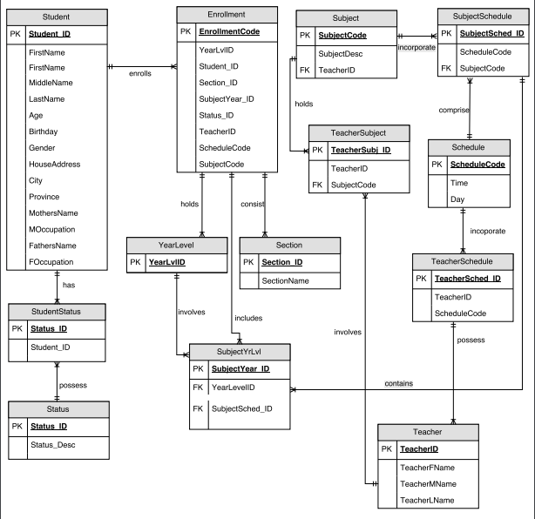
Database schema

Slide 7

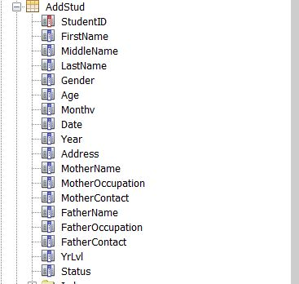

Database schema cont.
Status
Subject
Student

Slide 8

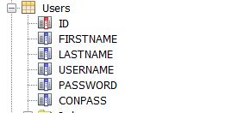
Database schema cont.
Teacher
Users

Slide 9
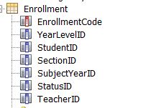


Database schema cont.

Slide 10



Database schema cont.

Slide 11



Database schema cont.

Slide 12
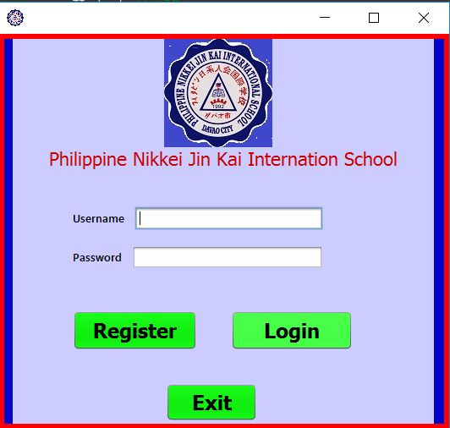
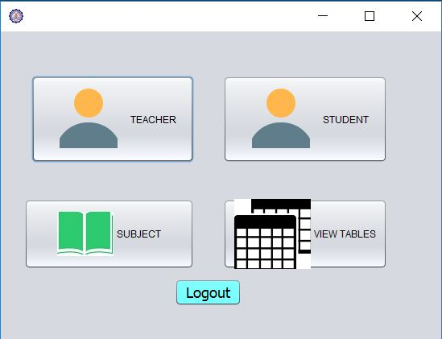
wireframe

Slide 13
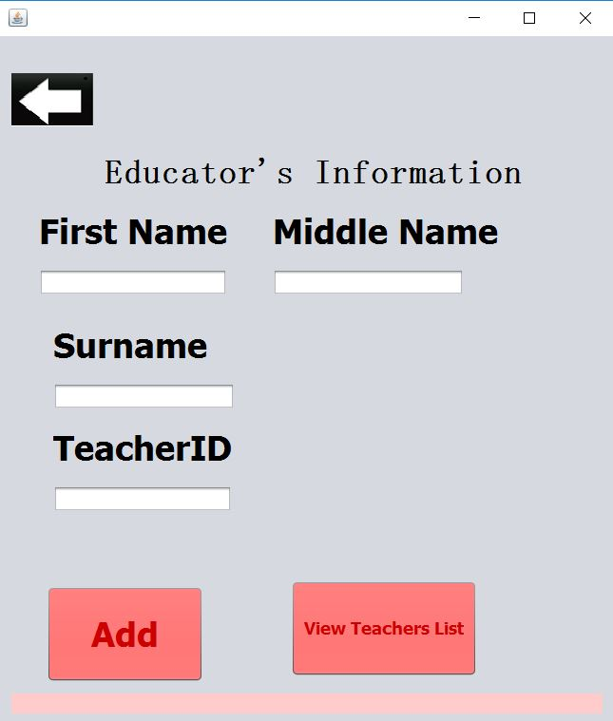
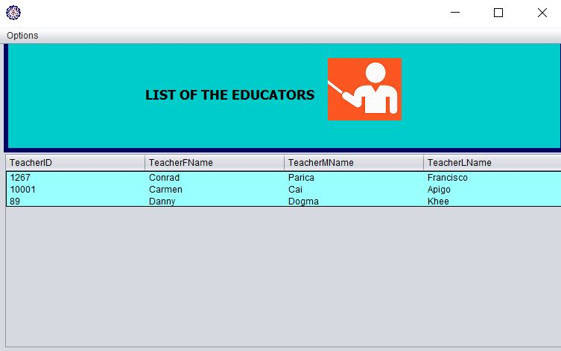
Wireframe cont.

Slide 14
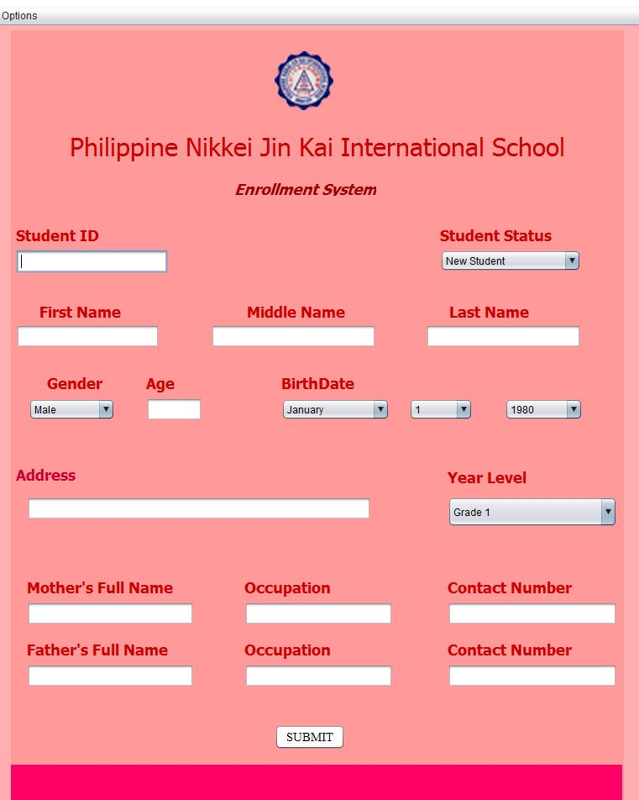
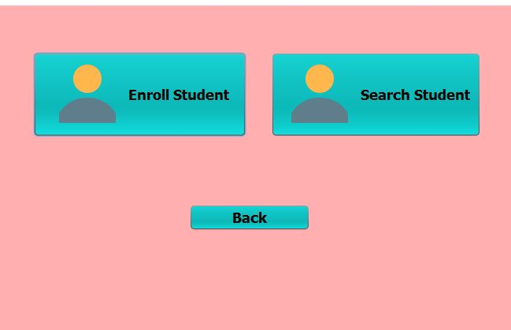
Wireframe cont.

Slide 15
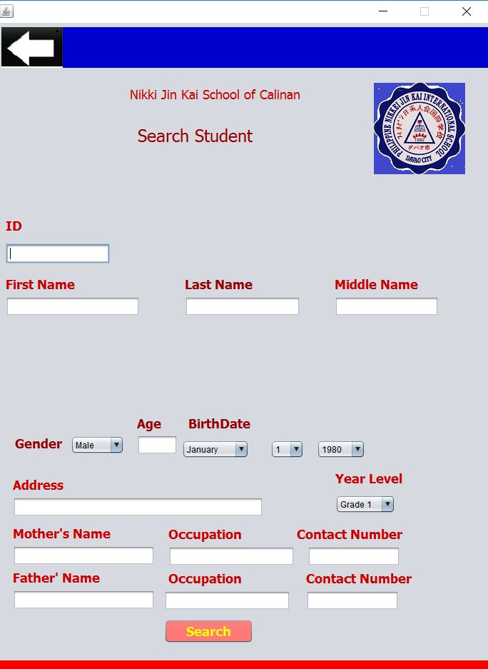
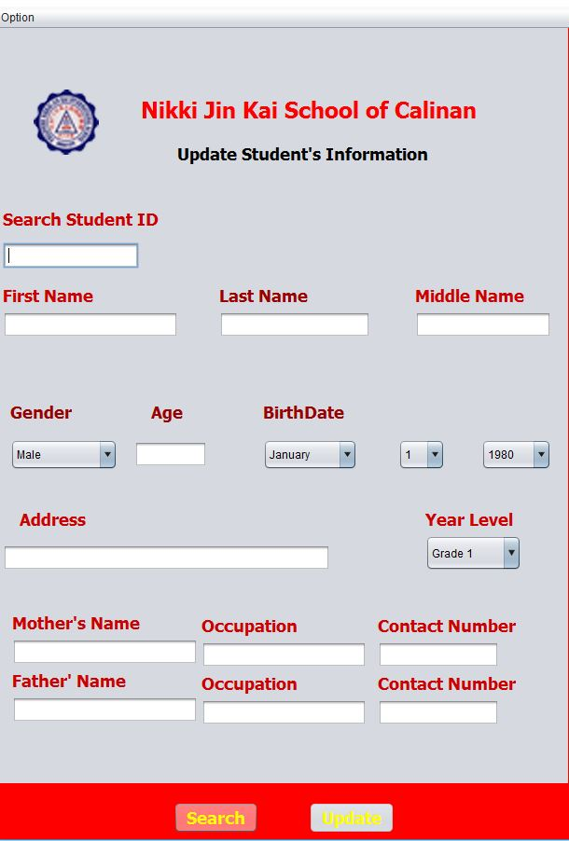
Wireframe cont.

Slide 16
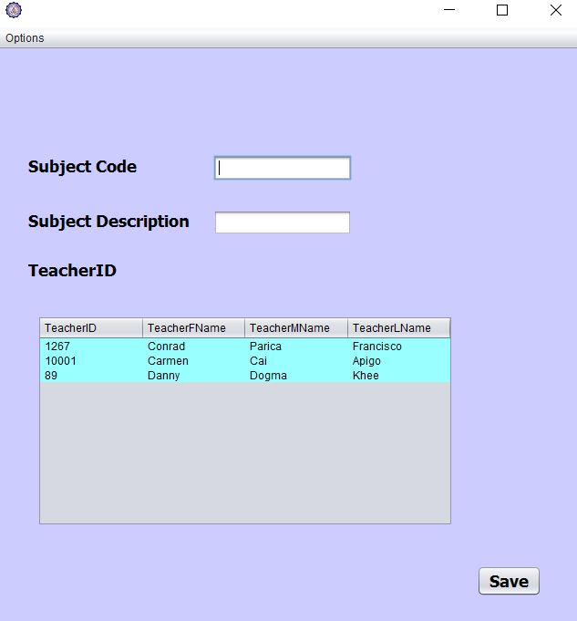
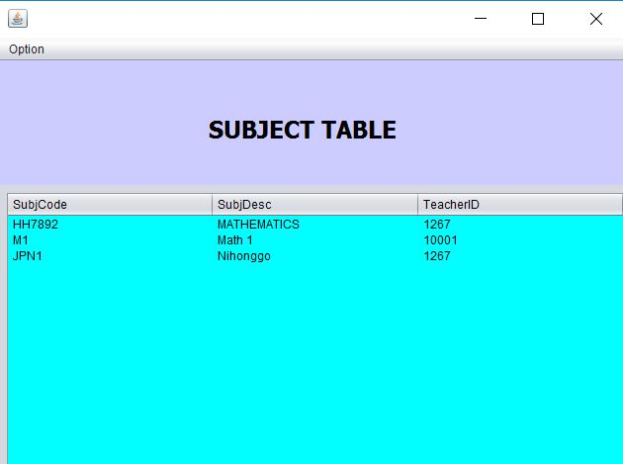
Wireframe cont.

Slide 17
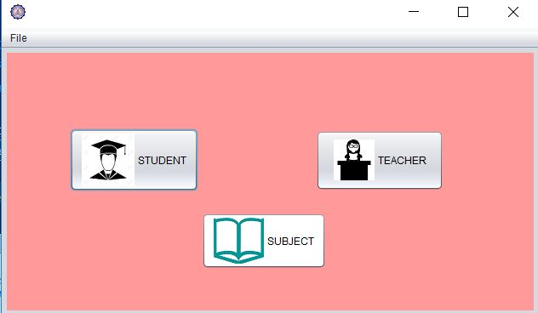
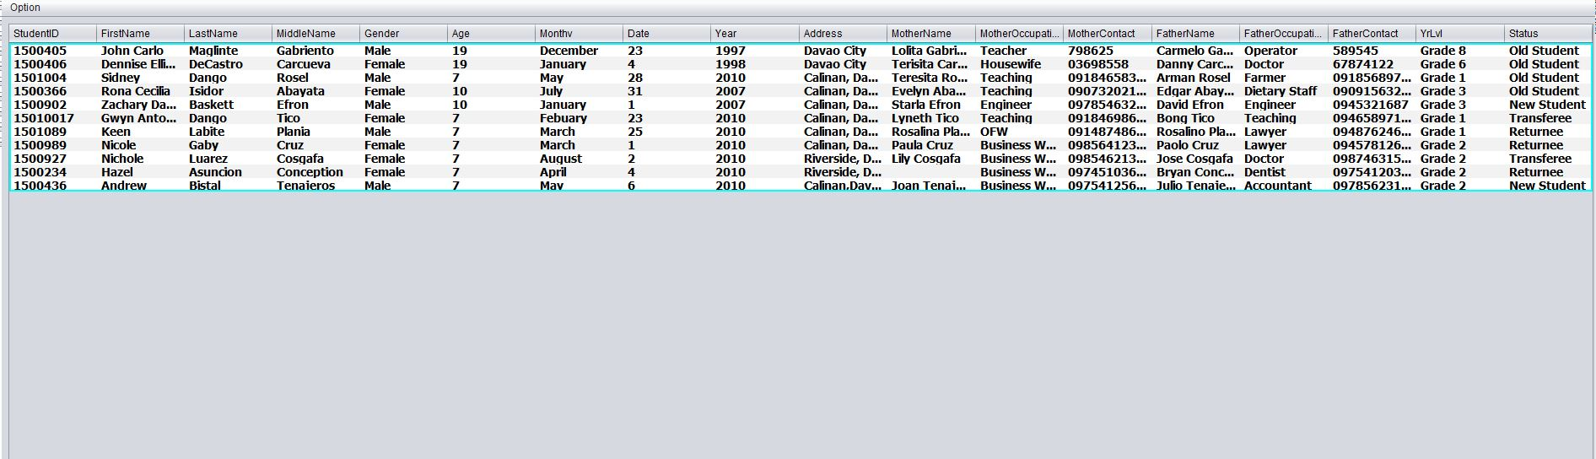
Wireframe cont.

Slide 18
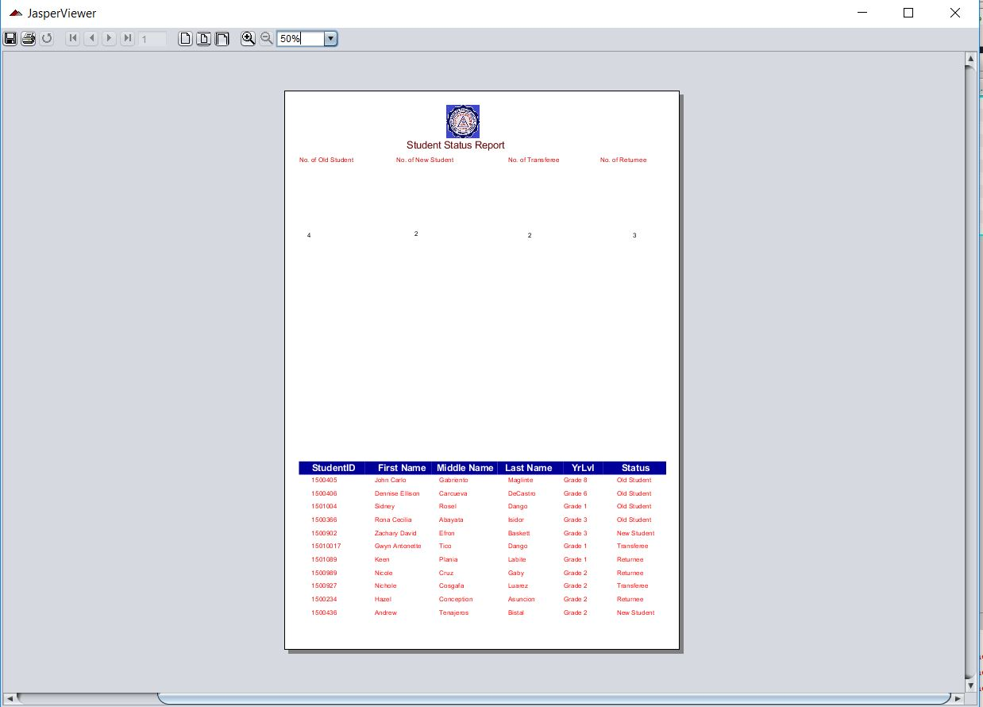
Wireframe cont.

Slide 19
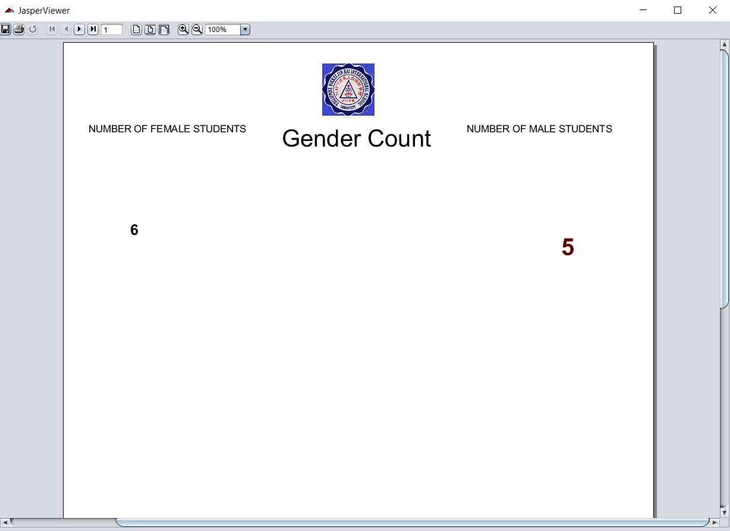
Wireframe cont.

Slide 20
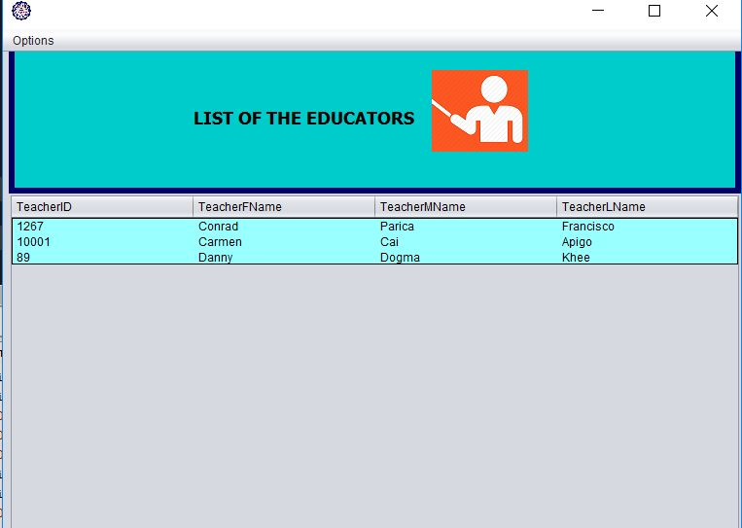
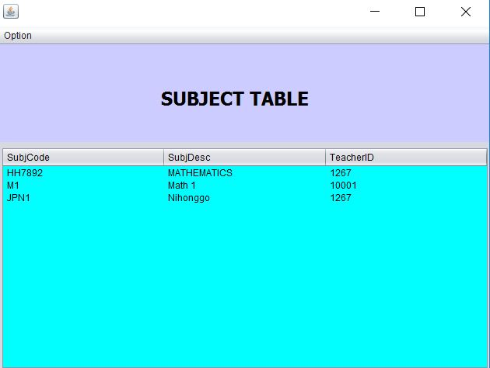
Wireframe cont.

